Slide 1
Software Engineering Concepts (CSC-205) BS(SE)/BS(CS)- III gg
Lecture 1

Slide 2

Agenda

Slide 3
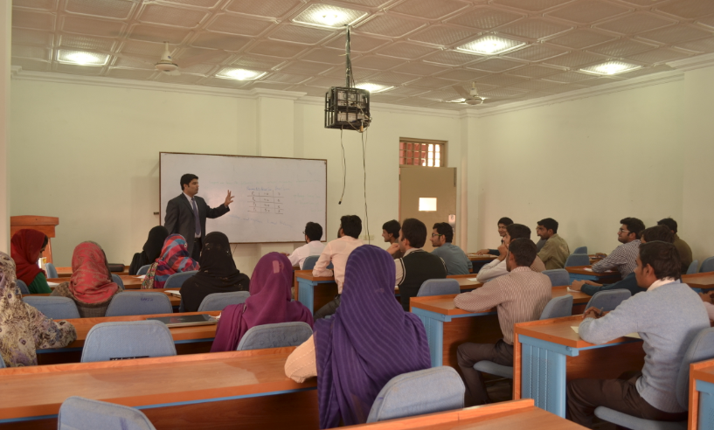

Introduction: Class
Name (brief intro)
Qualification and University
Motivation!! Why are you studying this course?
Expectation from this course (if any)!!

Slide 4

Course Description
This course introduces the different software process models by illustrating its phases and principles of software engineering.
Topics include:
Overview of Software Engineering;
Software Process Models;
Requirement Engineering Concepts;
Software Architecture and Design;
Design Modelling;
Software Quality Engineering;
Software Project Management;
Software Maintenance and Software Evolution.

Slide 5
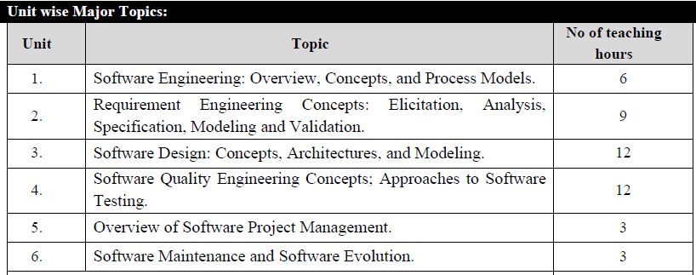

Slide 6
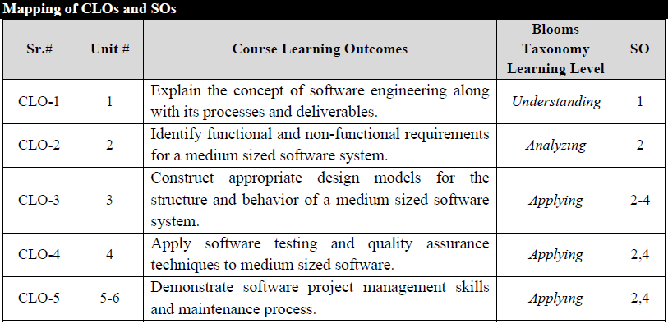

Slide 7
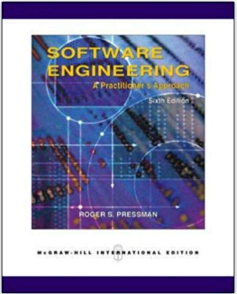
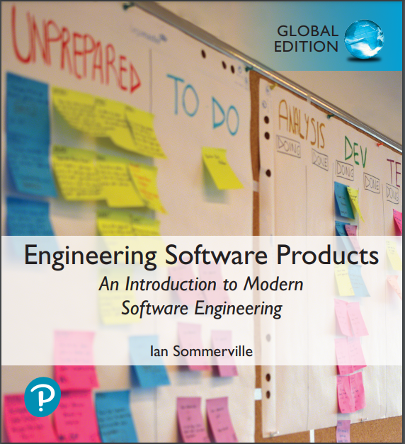
Recommended Books
Textbooks:
R. S. Pressman Engineering Software Products: An Introduction to Softwrae Engineering, Global Edition, Pearson Education Limited, 2021
Ian Sommerville , Engineering Software Products: An Introduction to Modern Software Engineering, Global Edition, Pearson Education Limited, 2021.
Reference Books:
Ian Sommerville, Software Engineering, Pearson Education Limited, 2016.
Bhuyan Unhelkar, Software Engineering with UML,, CRC Press, 2018.

Slide 8
Marks Distribution
Events | Marks
Quizzes + Assignments | 8
Term Project | 4
Mid-Term Examination | 18
Final-Term Examination | 30

Slide 9
What is Software?
Software
Programs
Documentation
Data
System Documentation
User Documentation

Slide 10
Types of Software
Generic products.
Stand-alone systems that are marketed and sold to any customer who wishes to buy them.
Examples – PC software such as graphics programs, project management tools; CAD software; software for specific markets such as appointments systems for dentists.
The specification of what the software should do is owned by the software developer and decisions on software change are made by the developer.
Customized or bespoke products.
Software that is commissioned by a specific customer to meet their own needs.
Examples – embedded control systems, air traffic control software, traffic monitoring systems.
The specification of what the software should do is owned by the customer for the software and they make decisions on software changes that are required.

Slide 11
What is Good Software?
Software has number of attributes which decide whether it is a good or bad . The definition of a good software changes with the person who evaluates it. The software is required by the customer , used by the end users of an organization and developed by software engineer . Each one will evaluate the different attributes differently in order to decide whether the software is good.

Slide 12
What are the attributes of good software?
The software should deliver the required functionality and performance to the user and should be maintainable, dependable and usable.
Maintainability
Software must evolve to meet changing needs
Dependability
Software must be trustworthy
Efficiency
Software should not make wasteful use of system resources
Usability
Software must be usable by the users for which it was designed

Slide 13
Software - Characteristics
Software has a dual role. It is a product, but also a vehicle for delivering a product.
Software is a logical rather than a physical system element.
Software has characteristics that differ considerably from those of hardware.
Software is developed or engineered, it is not manufactured in the classical sense.
Software doesn’t “wear out”.
Most software is custom-built, rather than being assembled from existing components.

Slide 14
Importance of software
Software can have a huge
impact in any aspect of
society.

Slide 15
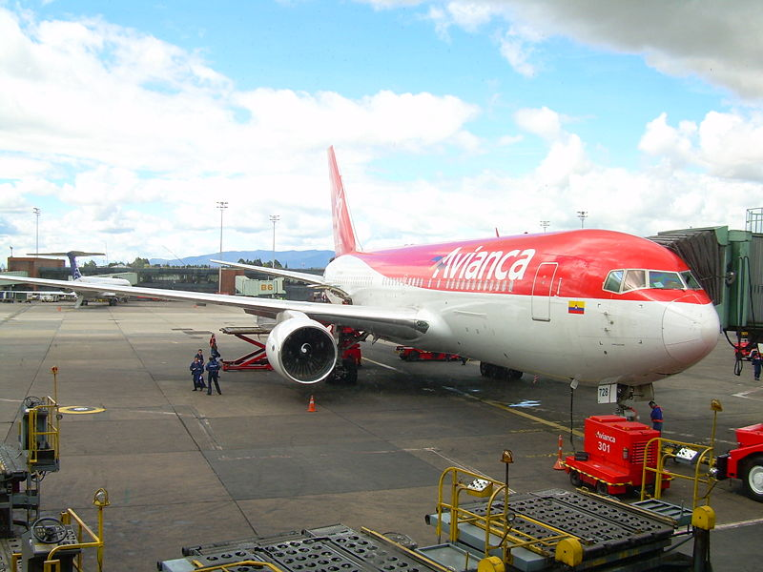
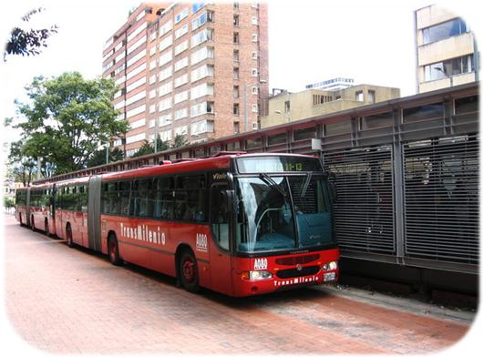
Where can you find software?

Slide 16
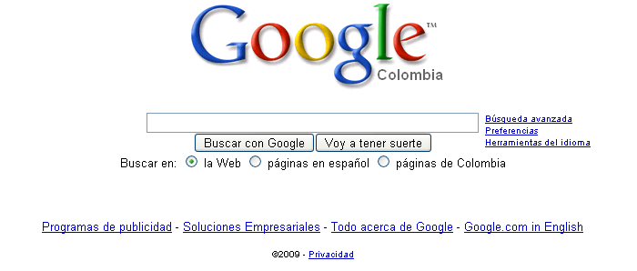
Some popular ones…

Slide 17
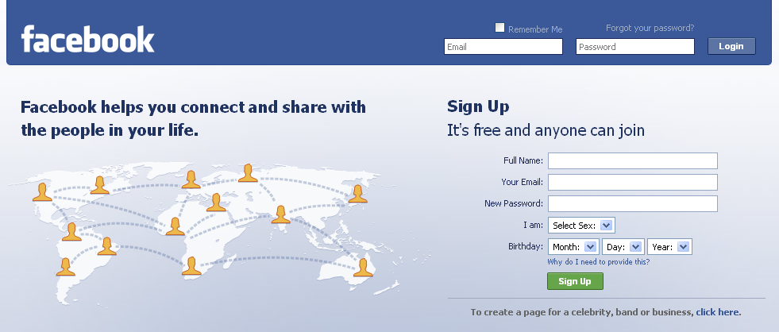
Some popular ones…

Slide 18
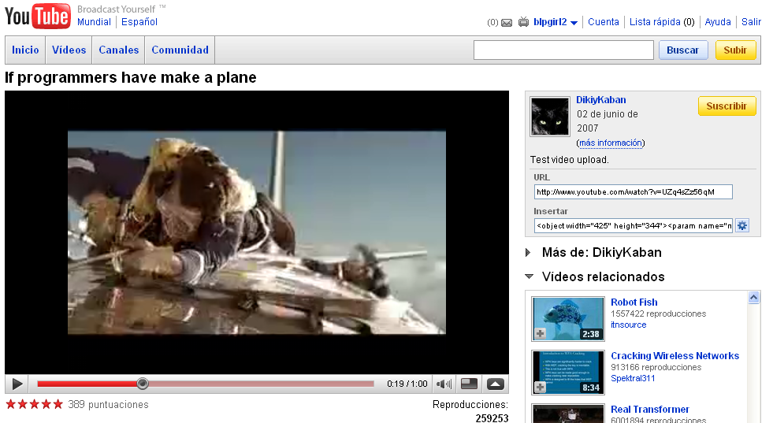
Some popular ones…

Slide 19
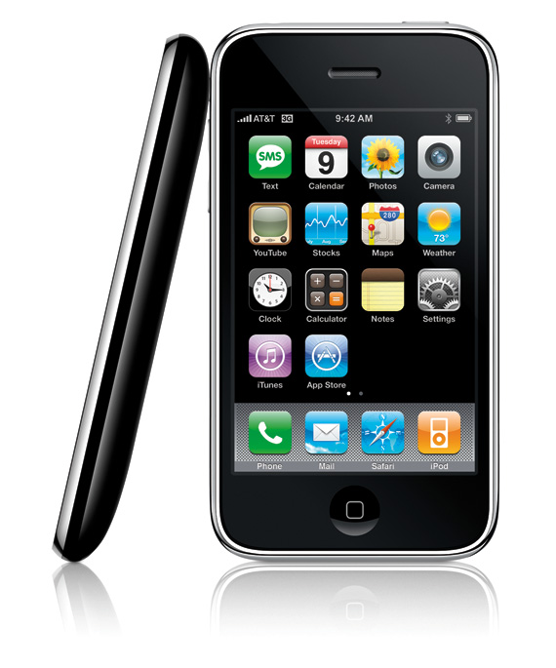
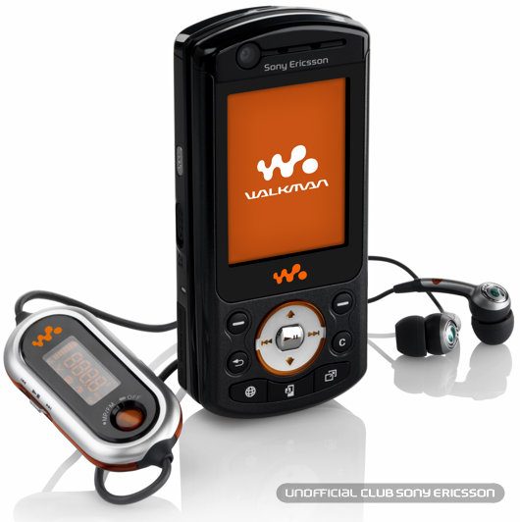
And even in…

Slide 20
Conclusion
Software is Almost
Everywhere.

Slide 21
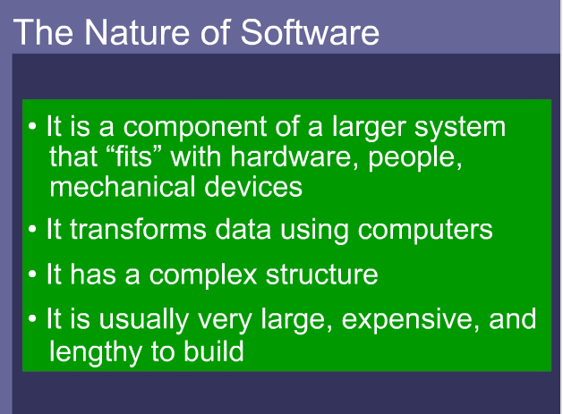

Slide 22

SE vs. CS
“Computer science is no more about computers than astronomy is about telescopes.” Edsger Dijkstra
Computer Science
Theory.
Fundamentals.
Software Engineering
Practicalities of software design, development and delivery.

Slide 23
Scientist vs. Engineer
Computer Scientist
Proves theorems about algorithms, designs languages, defines knowledge representation schemes
Has infinite time…
Engineer
Develops a solution for an application-specific problem for a client
Uses computers & languages, tools, techniques and methods
Software Engineer
Works in multiple application domains
Has only 3 months...
…while changes occurs in requirements and available technology
Isn’t there something more fundamental about “Software” Engineer?

